Slide 1
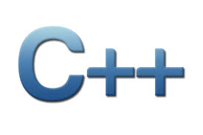

Css 332
Programming Issues with Object-Oriented Languages
Morteza Chini
Presentation material partially borrowed from learncpp.com

Slide 2

week 2
Autumn 2017
Memory Management, Pointers, Arrays
Presentation material partially borrowed from learncpp.com

Slide 3


Please respect your peers

Slide 4

UWB research opportunity

Slide 5

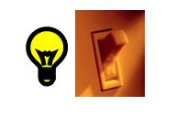
Components of memory
Computers store data in memory in 0s and 1s
The smallest piece of memory is a bit (Binary Digit)
A bit can hold either 0 or 1 (like a switch-- on or off)

Slide 6
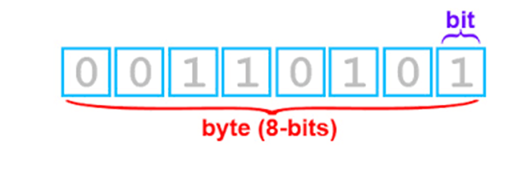
Bits & bytes
The next larger piece of memory is called Byte
8 bits put together are called a Byte
Each Byte would have its own address in memory, like a house
number on a street
Is it helpful to be able to get the address of a certain piece of memory?

Slide 7
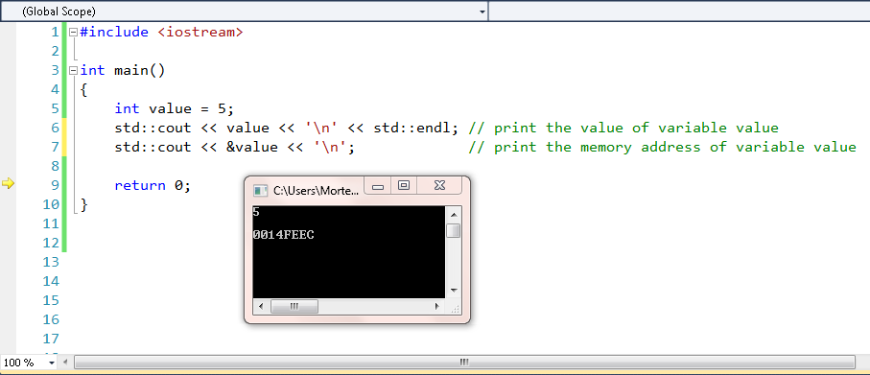
The address-of operator (&)

Slide 8
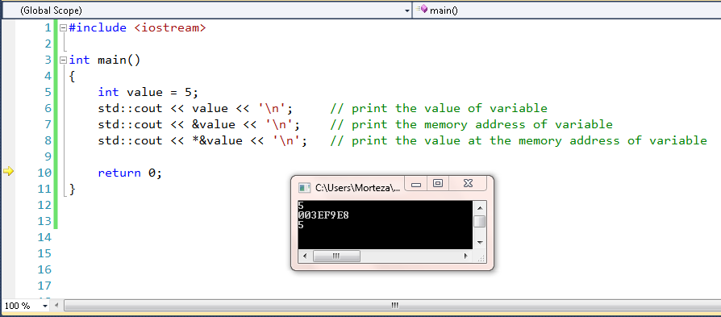
The dereference operator (*)
dereference operator (*) gets value at a particular memory address
NOTE: Multiplication operator is binary, the dereference operator is unary
Notes:
Note: Although the dereference operator looks just like the multiplication operator, you can distinguish them because the dereference operator is unary, whereas the multiplication operator is binary.

Slide 9
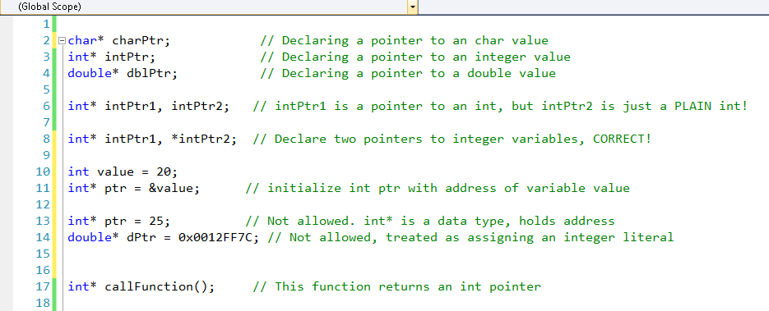
Pointer Declaration

Slide 10
Putting it all together
Pointers are variables that hold a memory address
Dereference a pointer(*) to retrieve the value at address it is holding
How to use pointer for now:
Arrays are implemented using pointers. Pointers can be used to iterate through an array instead of [] operator
Pointers are the only way you can dynamically allocate memory in C++, this is
by far the most common use case for pointers
Pointers can be used to pass a large amount of data to a function instead of inefficient process of copying data
Pointers are used to pass a function as a parameter to another function

Slide 11
fixed Arrays
#include <iostream>
int main()
{
int array[6] = { 13, 9, 7, 5, 3, 1 }; // Fixed array of 6 integers
// print the value of the array variable
std::cout << "The array has address: " << array << '\n';
The array has address: 0042FD5C
// print address of the array elements
std::cout << "Element 0 has address: " << &array[0] << '\n';
Element 0 has address: 0042FD5C
return 0;
}
NOTE: An array and a pointer to the array are NOT identical. Address held by the array variable is the address of the first element of the array

Slide 12
sizeof(): Arrays & pointers
Be careful when using sizeof() operator
When used on a fixed length array, sizeof() operator returns?
The size of the entire array (array length * element size)
int array[5] = { 32, 17, 9, 22, 12 };
std::cout << sizeof(array); //Prints sizeof(int) x array length (20)
When used on a pointer, sizeof() operator returns?
The size of a memory address (in bytes)
int* ptr = array;
std::cout << sizeof(ptr); // Prints the size of a pointer (4)

Slide 13
passing fixed arrays to functions
For efficiency reasons C++ does not copy arrays to be used as an argument to a function, instead it implicitly converts parameter array[] to *array
int main() {
int array[] = { 0, 1, 2, 3, 4, 15, 16, 17 };
std::cout << sizeof(array) << '\n';
// Prints sizeof(int) x array length = (32)
printSize(array);
return 0;
}
void printSize(int array[]) { // array is treated as a pointer, not a fixed array
std::cout << sizeof(array) << '\n';
// prints the size of a pointer (4 bytes), not size of the array (32 bytes)!!
}

Slide 14
passing fixed arrays to functions (cont.)
OK, Got it. C++ implicitly converts parameters using the array syntax ([]) to the pointer syntax (*)
What is the difference between these 2 function declarations, then?
void printSize(int array[]);
void printSize(int *array);
Welcome to C++
They are identical
Do all arrays in structs and classes get converted to pointers when the whole struct or class is passed to a function, just like above?
No. They remain as they were passed to the functions within the class or sturct.

Slide 15
Indexing arrays
To access a particular element in the array, the syntax is:
integerArray[element] -- exactly like in Java
To access the tenth element in the array we wrote:
integerArray[9]
C++ automatically dereferences your [ ]. Even though integerArray is a pointer to integers, e.g., integerArray[9],it returns an integer (int) not a pointer to one (int *). Thus this is allowed:
integerArray[10] = integerArray[5] + integerArray[0] - 8;

Slide 16
pointer arithmetic
Arrays store all their elements in memory consecutively. Indexing specifies how far to go
along in memory from the first element
integerArray[0] → "the integer at memory address integerArray“
integerArray[1] → "the integer at memory address integerArray + 1", and so on, right?
We could index an array, without using the [] operators by adding an offset to the start of the array
*(integerArray + index) will get us the value stored at a specific index
integerArray[index] is the same as *(integerArray + index)
NOTE: Accessing something at a memory address, requires dereferencing that memory address,
hence the "*"

Slide 17
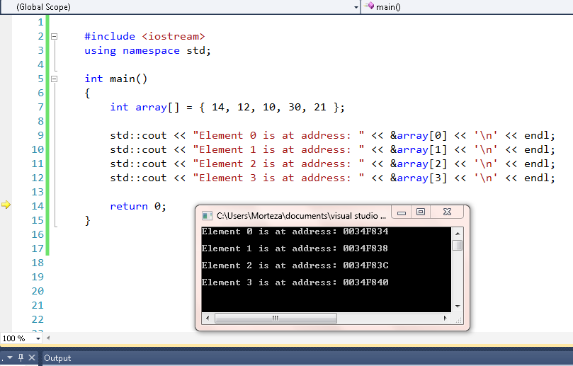
Pointer Arithmetic and scaling
Arrays are laid out sequentially in memory; integers are 4 bytes apart

Slide 18

indexing beyond bounds
Consider int array[5] = {32, 17, 9, 22, 12};
Arrays store all their elements in memory consecutively. What if we walk off the end of the array or access an element that does not exist? Not that we ever do!!
In Java we got: java.lang.ArrayIndexOutOfBoundsException , No such a luxury in C++.
What if we did this?
integerArray[-2]; Translates to the memory address for this memory location: (integerArray - 2)
integerArray[-10] = 34; What does this pointer point to? Who knows? What now?
Application might crash, it might behave unexpectedly, you might get a segmentation fault, bus error, some unintended results, or …….

Slide 19
C++ memory allocation
C++’s memory allocation types:
Static memory allocation for static and global variables. Memory is allocated once when program is run and persists during it’s life cycle
Automatic memory allocation happens for function parameters and local variables. Memory is allocated when the relevant block is entered, and freed when the block is exited, as many times as necessary
Both static and automatic allocation have two things in common:
The size of the variable/array must be known at compile time
Memory allocation and deallocation happens automatically (when the variable is instantiated/destroyed)
What if we don’t have one or both of this information available such as size of a file input?

Slide 20

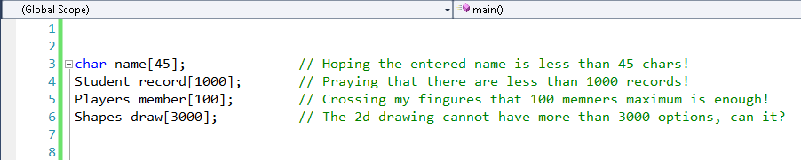

Why go dynamic?
We may want to use a string to hold someone’s name, but the length is unknown to us
We may want to read in a number of records from disk, we don’t know in advance how many records there are
We may be creating a game, with a variable number of players signing in and quitting
Or, we could think ahead. what do you think?

Slide 21
Dynamic memory allocation
Dynamically allocates a double (and discards the result)
new double;
Dynamically allocate a double & assign the address to ptr for future access
double* ptr = new double; (int num = new int(); -- in java)
Assign value of 7.6 to allocated memory
*ptr = 7.6;
Dynamically allocate an array of integer s and deallocate memory after done
int* dynamicArray; //create the pointer of type needed
dynamicArray = new int[10]; //declare array of size 10 int values
delete [] dynamicArray; //one delete per every new used
Are we done here?

Slide 22
Preventing memory leaks
With dynamic memory allocation the programmer is responsible for requesting and disposing of allocated memory, unlike static or automatic memory allocation
When done with a dynamically allocated variable, we need to explicitly instruct C++ to free the memory for reuse
For single variables, (non-array) form of the delete operator:
delete ptr;
ptr = null;
For arrays of different types
delete [ ] myArray; one delete per every new used

Slide 23
Handling end-of-file (eof) correctly
The eof() function -- infile.eof(), is a bool function which is true if the EOF character has been read, or false otherwise
Even though you read the last item in a file, the eof function may not be true yet
Often you have to read past the last item in the file to read the EOF character
Unix/Linux vs. Windows
Linux -- every line in a file has an End-Of-Line (EOL) character and the EOF character is after the last line. So unix/linux file's last line is stuff, EOL, EOF
Windows -- each line has an EOL characters except the last line whereas windows file's last line, if the cursor is on the line, is stuff, EOF

Slide 24
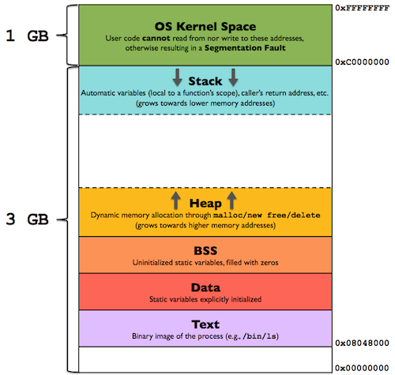
memory structure
Memory segments used by a C++ program:
The code segment (text segment), where the compiled program sits in memory, typically read-only
The bss segment (aka the uninitialized data segment), where zero-initialized global and static variables are stored
The data segment (also called the initialized data segment), where initialized global and static variables are stored
The heap, where dynamically allocated variables are allocated from
The call stack, where function parameters, local variables, and other function-related information are stored

Slide 25
The Heap
The heap segment (aka free store) keeps track of memory used for dynamic memory allocation
Use of the new operator to allocate memory, this memory is allocated in the application’s heap segment
Delete dynamically allocated variable to free the heap memory
Remember that deleting a pointer does not delete the variable, it just returns the memory at the associated address back to the operating system
int *ptr = new int; ptr is assigned 4 bytes in the heap
int *array = new int[10]; array is assigned 40 bytes in the heap

Slide 26
what about the heap
Allocating memory on the heap is comparatively slow
Allocated memory stays allocated until it is specifically deallocated (beware memory leaks) or the application ends (at which point the OS should clean it up)
Dynamically allocated memory is accessed through a pointer
Dereferencing a pointer is slower than accessing a variable
The heap is a big pool of memory, large arrays, structures, or classes are allocated there, hence the slowness

Slide 27
The stack
The call stack (aka the stack -- LIFO) is very active and keeps track of all the active functions (those that have been called but have not yet terminated) from the start of the program to the current point of execution, and handles allocation of all function parameters and local variables
The call stack segment holds the memory used for the call stack
At start of application, the main() function is pushed on the call stack by the operating system. Then the program begins executing
When a function call is encountered, the function is pushed onto the call stack. When the current function ends, that function is popped off the call stack(used in recursion) Thus, by looking at the functions pushed on the call stack, we can see all of the functions that were called to get to the current point of execution

Slide 28

How about the stack
Allocating memory on the stack is comparatively fast
Memory allocated on the stack stays in scope as long as it is on the stack. It is destroyed when it is popped off the stack
All memory allocated on the stack is known at compile time Because the stack is relatively small, it is generally not a good idea to do anything that eats up lots of stack space. This includes passing by value or creating local variables of large arrays or other memory-intensive structures.

Slide 29
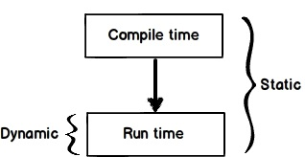
Compile Time vs. run time
Compile time
The program doesn’t have to be well-formed
What is checked by compiler:
Any potential syntax errors
Typechecking for potential mismatch
Program either complies or crashes
If program compiles fine:
The program was well formed
we can run the program with no problem
What are the inputs and outputs?
Input was program, any header files, interfaces, libraries, needed to successfully compile.
Output is either error messages or hopefully code that machine can interpret.
Run time
We know nothing about the program's invariants,
programmer should check all invariants
Some run-time errors:
Division by zero
Dereferencing a null pointer
Running out of memory
Trying to open a non-existing file
If nothing goes wrong, the program finishes
Inputs and outputs are files, text on screen,
network packets, any other outcome expected

